Slide 1

MENTAL SKILLS – CONCENTRATION
Most sports have both an external focus and an internal focus component if performance is to be successful.
A batsman in cricket starts with a broad external focus as he prepare to face the bowler. He looks around to see where the fielders are positioned, how far away they are from the bat etc. and analyses this information.
As the bowler starts his run up, he switches to a narrow external focus to concentrate on the bowler and narrows his focus even further to concentrate on only one cue – the ball.
This process of refocusing is referred to as shifting attentional focus
www.flickr.com/photos/95438214@N00/3067320775/
http://www.flickr.com/photos/95438214@N00/3067320775/
/www.flickr.com/photos/crusey/560286681/
Home

Slide 2
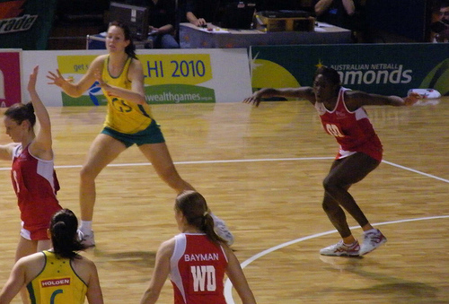
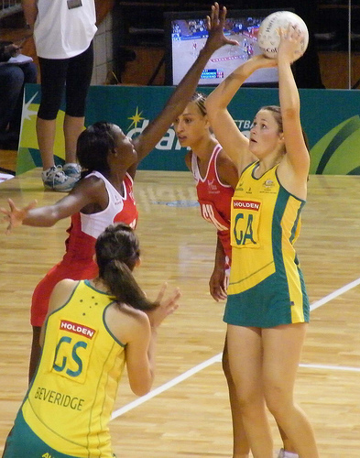
MENTAL SKILLS – CONCENTRATION
A goal shooter in netball uses broad – external attention as she needs to focus on the ball and the movement of the other players on the court.
When she has the ball, her focus changes to a narrow – external as she concentrates only on shooting the ball at the target.
Narrow – internal attention is used to visualise the ball going into the goal.
www.flickr.com/photos/28990363@N05/2935952110/
www.flickr.com/photos/28990363@N05/2935899020/
Broad - External
Narrow - External
Home

Slide 3
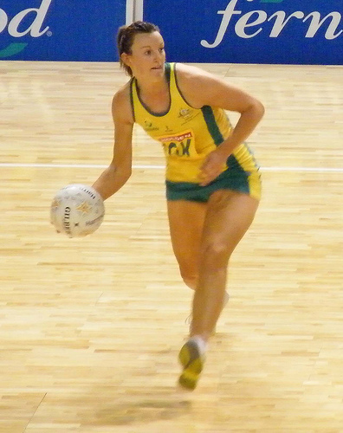
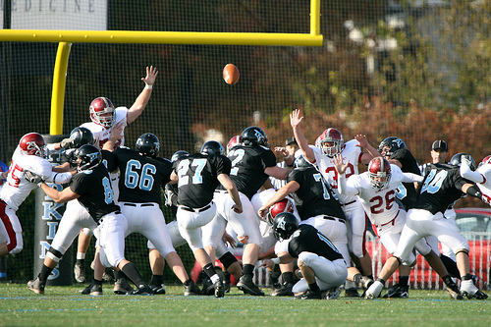
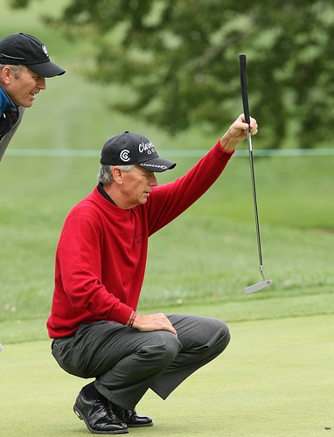
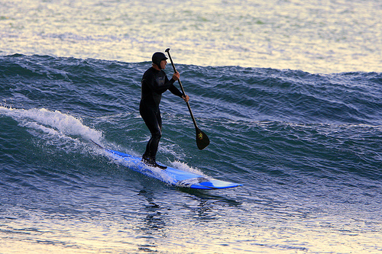
MENTAL SKILLS – CONCENTRATION
Discuss the pictures with reference to Nideffer’s Model of Attention
www.flickr.com/photos/keithallison/2310980563/in/set-72157604046925625/
www.flickr.com/photos/28990363@N05/2935096579/in/set-72157607420048113/
Home
www.flickr.com/photos/mikebaird/309936602/in/set-72157594398340326/
www.flickr.com/photos/keithallison/3969560335/in/set-72157604047766899/

Slide 4
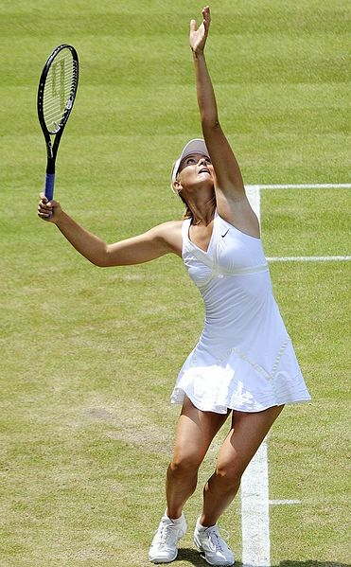
Concentration problems can be; 1. Internally caused 2. Externally caused
MENTAL SKILLS – CONCENTRATION
Internal Distracters
Attending to past events and past consequences – “last time I missed the shot……”
Attending to future events and possible consequences – “if I miss this shot ……..
Attending to irrelevant cues
Over-analysis of technique
Game pressure – choking
Maria Sharapova needs to maintain focus on the present to avoid irrelevant distractors which could negatively affect her performance.
https://sco.m.wikipedia.org/wiki/File:Maria_Sharapova_at_the_2009_Wimbledon_Championships_12_(cropped).jpg
Home

Slide 5
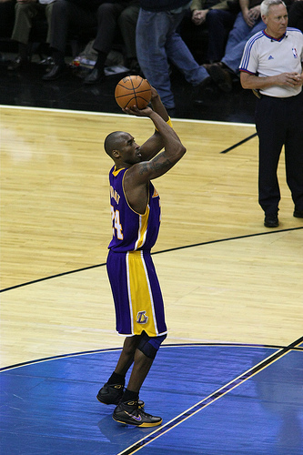
MENTAL SKILLS – CONCENTRATION
External Distracters
Opponents / crowd deliberately trying to distract a performer’s attention from the task at hand.
Verbal distracters e.g. sledging
Visual distracters e.g. the goalkeeper swaying from side to side as a player prepares to take a penalty
What external distractors could be present in this scenario?
www.flickr.com/photos/keithallison/3085765671/in/set-72157610728111993/
Home

Slide 6
MENTAL SKILLS – CONCENTRATION
Strategies to improve concentration and reach the ‘Zone’
Sometimes referred to as “desensitisation” training
Have “open” training sessions with spectators allowed to watch. Get team accustomed to various environments.
Some coaches have trained with simulated crowd noise being played on a stereo system to get players accustomed to the distraction.
A batter in cricket can use a cue word or phrase e.g. “only the ball” as the bowler begins their run up to fully focus on the upcoming delivery and ignore everything else.
Develop a simple and consistent routine which can be used prior to performing a skill
Practice with distractions present
Use key words to focus on present demands
Establish consistent performance routines
Home

Slide 7
MENTAL SKILLS – CONCENTRATION
Recreating game situations at training allows players to recognise cues in the environment that will then improve performance
E.g. a football game can be divided into 4 x 25 minute contests with each contest having short term goals
e.g. when playing into the wind, keep the opposition down to 4 goals for the period and scoring 1 goal themselves. When with the wind, aim to kick 5 goals and concede only 1.
Simulate game specific situations during training
Break the contest into smaller blocks of time
https://commons.wikimedia.org/wiki/File:ANA_IVANOVIC_(6710768925).jpg
Home

Slide 8
MENTAL SKILLS – CONCENTRATION
Self-confidence increases if individuals are confident that the game plan or strategy is appropriate for the upcoming performance and that they have the skills necessary to fulfill their expected role in the contest.
Positive feedback given either during or after the game re-enforces the good things a player has done.
This results in an increase in the self-confidence of the player involved and an increased likelihood of the player repeating the behaviour.
Creating a mental image of a perfect performance using as many senses as possible.
Confident of game plan/tactics
Positive feedback
Imagery
Home

Slide 9
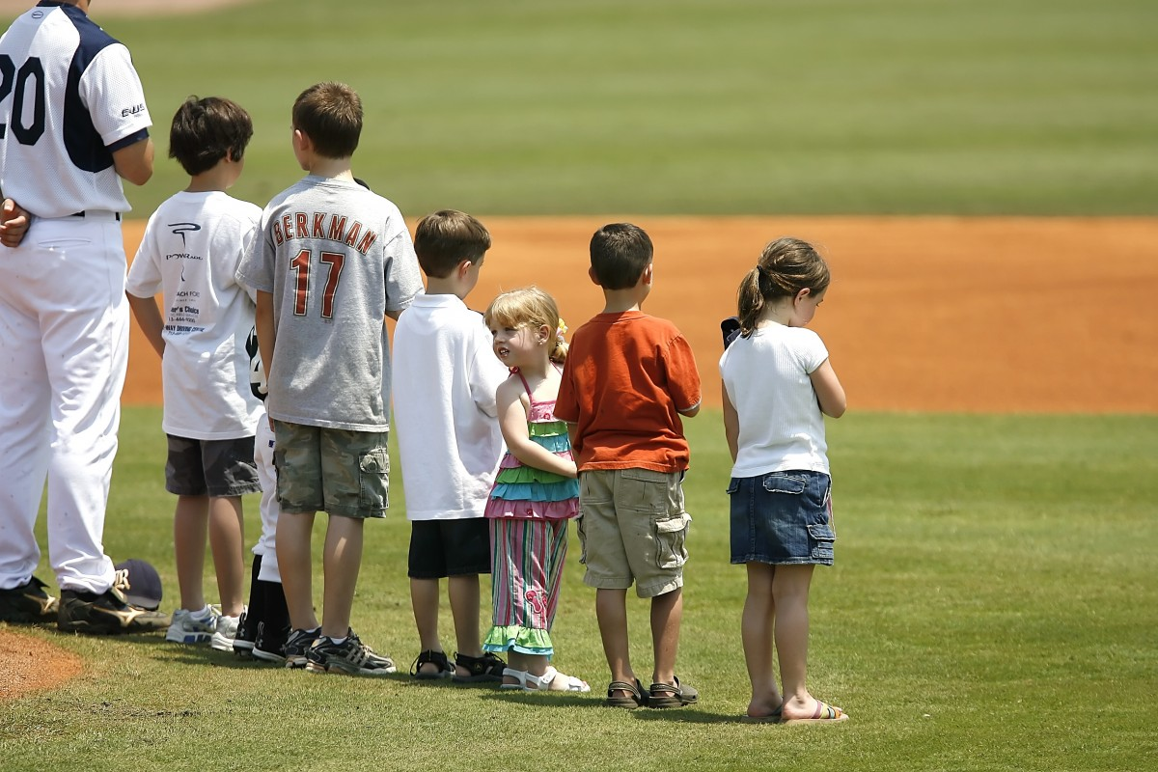
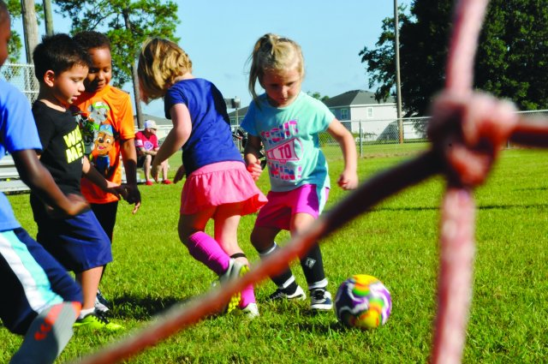
MENTAL SKILLS – CONCENTRATION
Influence of age
The ability to maintain concentration is heavily influenced by age
Typically the younger the individual, the more likely they are to lose focus on a regular basis
This is important for coaches who must reduce the length of drills and activities in order to maintain the attention of the individuals
As a result older children learn faster than younger children because of a longer attention and concentration span.
https://pxhere.com/en/photo/593170
https://www.army.mil/article/211797/cys_sports_helps_develop_minds_bodies
Home

Slide 10
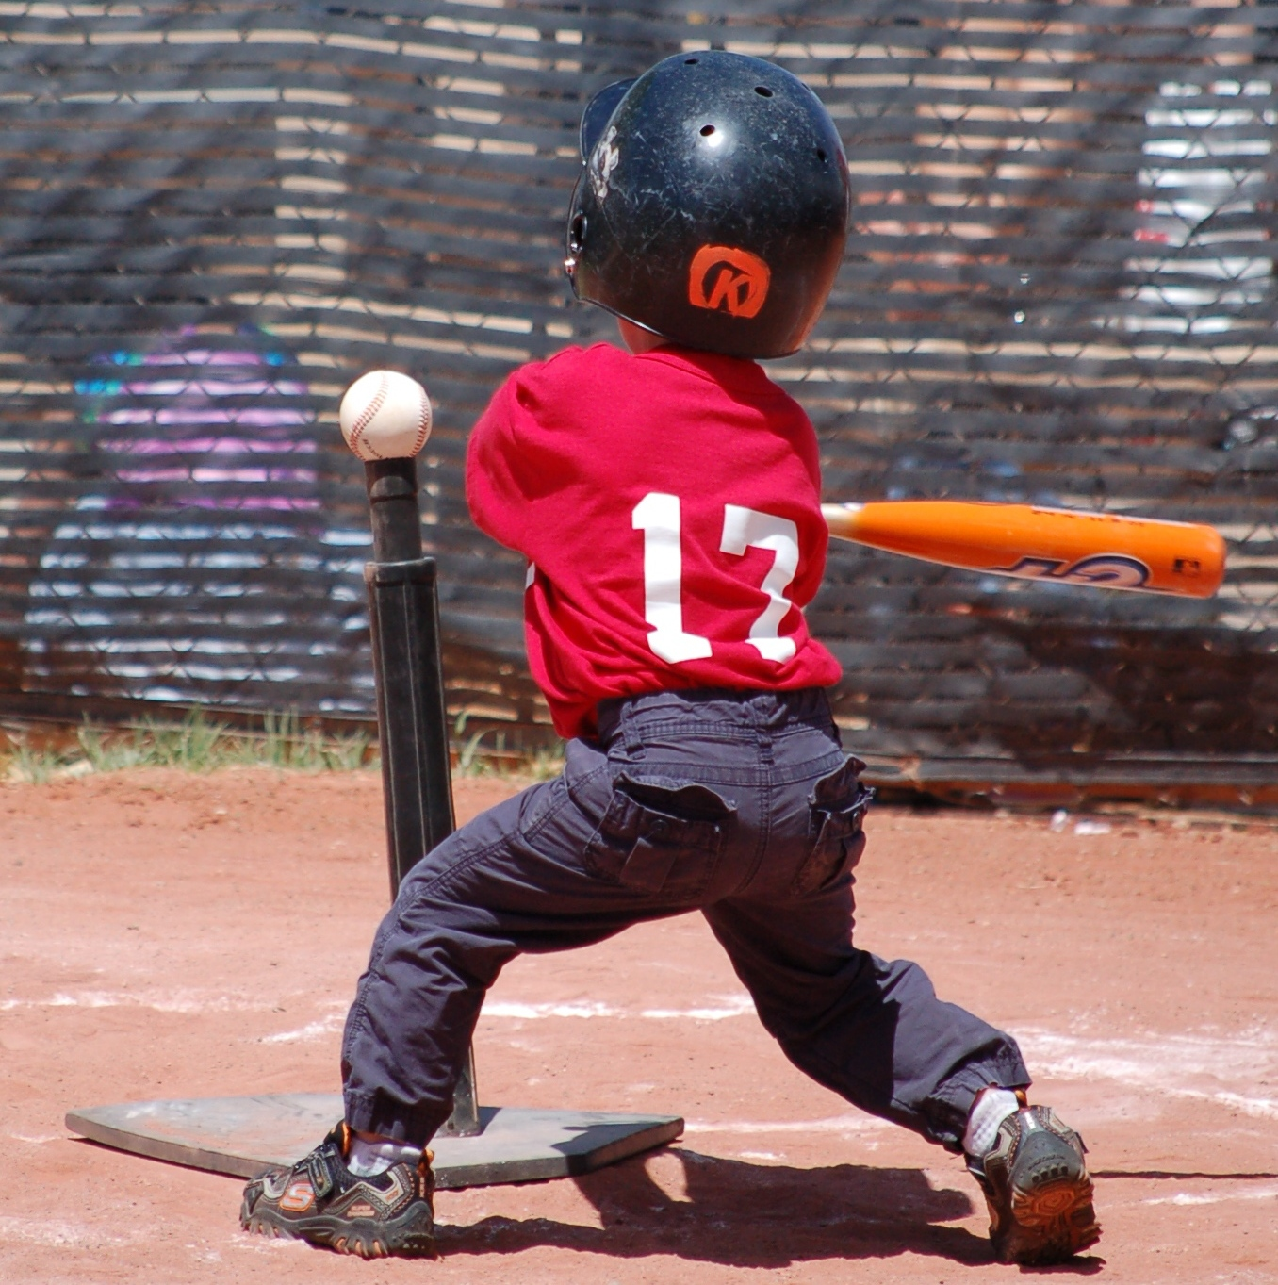
MENTAL SKILLS – CONCENTRATION
Influence of skill level
The ability of an individual to attend to relevant stimuli is influenced by their skill level
As discussed earlier, highly skilled athletes are better able to attend to relevant stimuli whilst ignoring distractions
As a result, when coaching less skilled participants, coaches must provide more predictable, closed environments, allowing the players to focus on a reduced number of stimuli
As the players become more skilled, the environment can become more open, allowing the individuals to develop the ability to filter out distractions whilst also shifting their attention from one stimuli to the next.
https://commons.wikimedia.org/wiki/File:Tee_ball_player_swinging_at_ball_on_tee_2010.JPG
Home

Slide 11
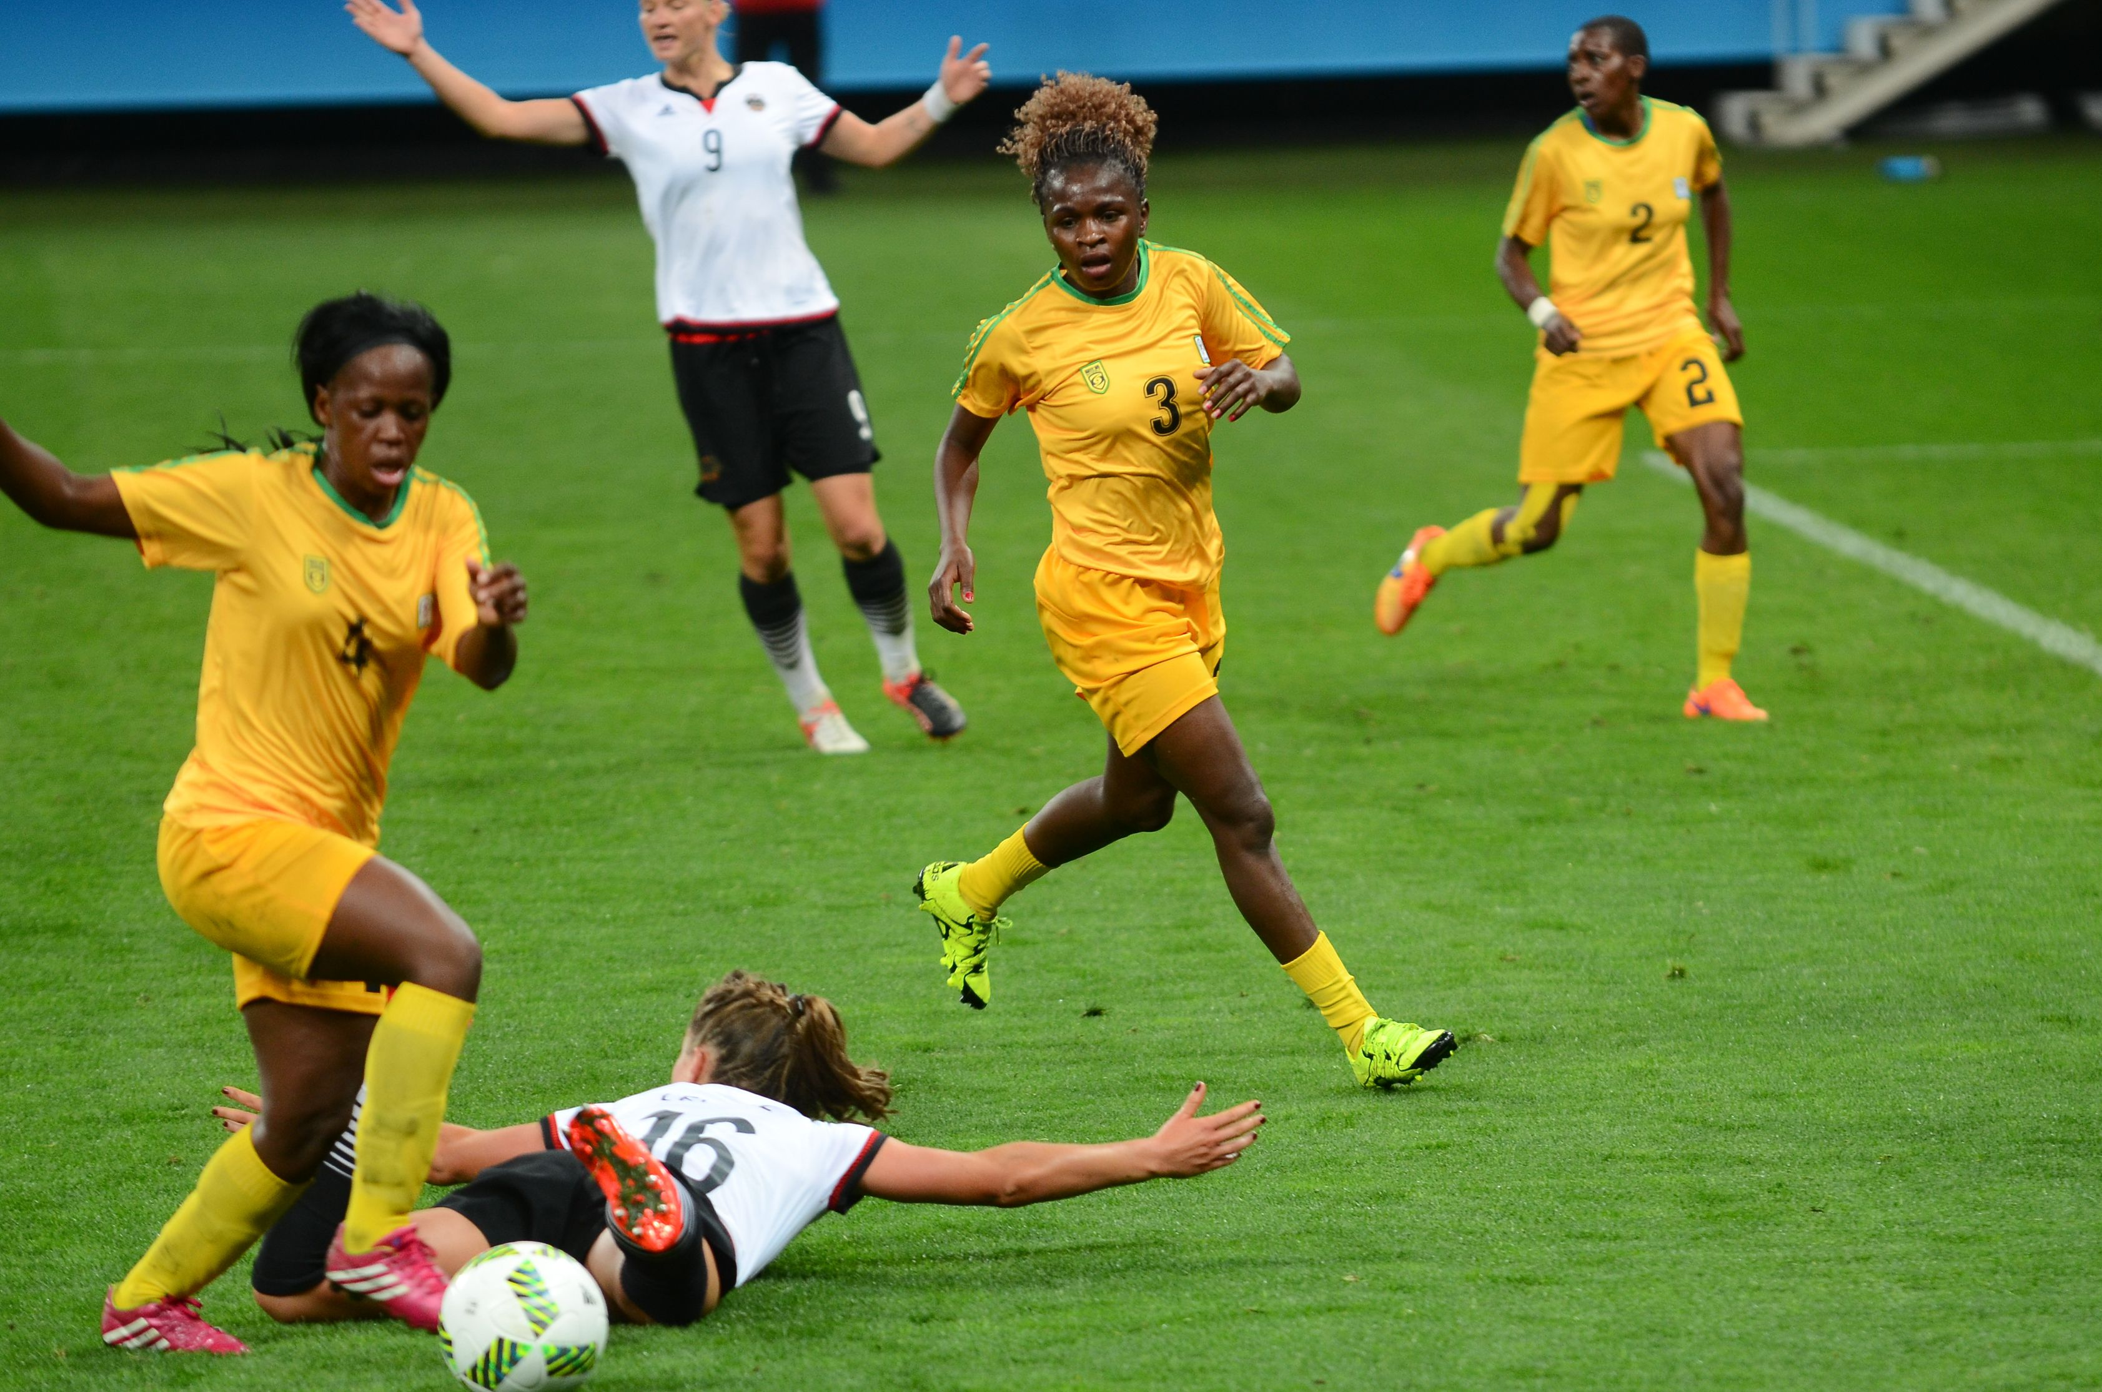
MENTAL SKILLS – CONCENTRATION
Influence of activity type
Activities that provide constantly changing stimuli are more likely to maintain the attention and focus of an individual
This is further enhanced by whether an individual finds the task enjoyable
Compare the attentional demands of a soccer goal keeper to a midfielder
The soccer goal keeper is able to switch off whilst the ball is at the opposite end of the field whilst the midfielder must maintain concentration at all times.
Home
https://commons.wikimedia.org/wiki/File:Female_soccer_at_2016_summer_Olympic_Games_in_Rio_de_Janeiro._Zimbabwe_vs_Germany.jpg

Slide 12
MENTAL SKILLS – AROUSAL
Mental skills required for improving performance and achieving the ideal performance state (‘the zone’)
intrinsic motivation
self-confidence
stress management
concentration or attentional control – Nideffer’s model
arousal regulation for optimal performance including the inverted U hypothesis
influence of age, skill level, and type of activity on mental skills in relation to
motivation
arousal regulation (inverted U hypothesis)
concentration
School Curriculum and Standards Authority. Physical Education Studies ATAR Year 11 Syllabus, 2016.
Home

Slide 13
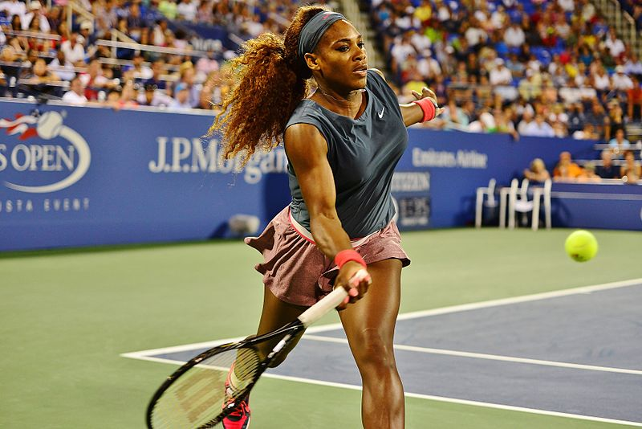
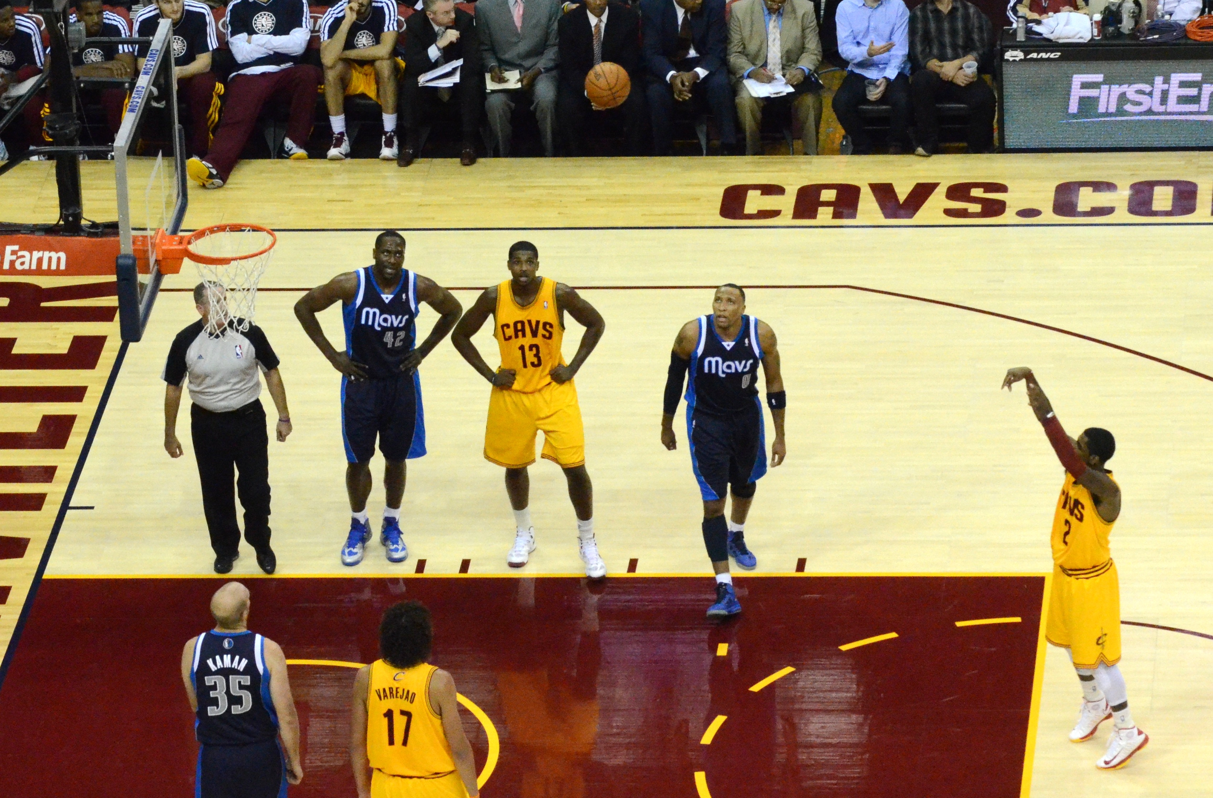
MENTAL SKILLS – AROUSAL
Arousal is the degree of stimulation or alertness present in a individual about to perform a given task.
Athletes need an optimal level of arousal to experience success. The relationship between arousal & performance is shown by the inverted-U hypothesis (or graph).
It is possible to experience situations of under-arousal, optimal arousal (also referred to as being in ‘the zone’) & over-arousal.
https://commons.wikimedia.org/wiki/File:Serena_Williams_(9630783949).jpg
https://commons.wikimedia.org/wiki/File:Kyrie_Irving_Free_Throw.jpg
Home

Slide 14
MENTAL SKILLS – AROUSAL
The arousal continuum is used to show the range of states present in a performer, ranging from under-aroused to over-aroused
Level 1 - Relaxed drowsiness
Level 2 - Wakefulness
Level 3 - Curiosity and attentiveness
Level 4 - Joy
Level 5 - Exhilaration
Level 6 - Anxiety
Level 7 - Panic
Level 8 - Rage
Under aroused
Over aroused
Home

Slide 15
MENTAL SKILLS – AROUSAL
An optimally aroused performer attends only to relevant stimuli in the environment and can shift their attention quickly to meet the needs of the situation.
An under aroused performer lacks the intensity to attend to all the relevant stimuli in the environment and their attention is focused on other non-relevant thoughts which detracts from their performance.
e.g. a bored slips fielder in cricket who is thinking about going clubbing instead of concentrating on the game will probably drop the next catch that comes his way
An over aroused performer has a decreased ability to shift their attentional focus. Athletes in this state often have narrow internally focused attention therefore can miss important cues in the environment.
e.g. does not spot an unmarked player in a scoring position
https://www.flickr.com/photos/naparazzi/2927067231
Home

Slide 16
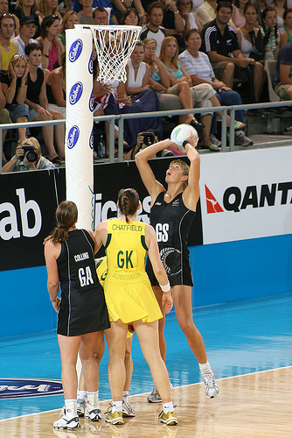
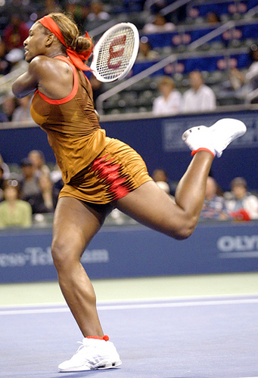
MENTAL SKILLS – AROUSAL
When athletes perform at their optimal arousal level, they are able to concentrate specifically on the demands of the task without becoming either over or under aroused.
Athletes performing at this level are said to be in “The Zone” or "Flow State”.
A performer at their optimal arousal level has an increased likelihood of a successful performance.
Over aroused or under aroused performers do not produce optimal levels of performance.
www.flickr.com/photos/foraggio/120235312/
www.flickr.com/photos/rafamado/2669830143/
Home

Slide 17
MENTAL SKILLS – AROUSAL
The “Inverted U hypothesis” shows the relationship between arousal and performance
Optimal Performance and optimal arousal occurs at this point of the curve
Performance
Under aroused
Muscles feel heavy
Concentration drops
Enthusiasm decreases
Bored
Tired
Unwell
Over aroused
Muscles become tense
Movements jerky
Coordination drops a
Mistakes increase
Feel Anxious
Arousal
Home

Slide 18
MENTAL SKILLS – AROUSAL
There is a curvilinear relationship between arousal and performance:
Yellow section of the curve indicates a state of under-arousal and performance will be less than optimal and attention being given to irrelevant cues and a lack of concentration.
Green section shows the optimum arousal level with the corresponding optimal performance level. Performer is in “The Zone”.
Red section shows a state of over-arousal with the corresponding drop in performance due to increased muscular tension and the missing of important cues in the environment.
Performance
Arousal
Home

Slide 19
MENTAL SKILLS – AROUSAL
Under vs over aroused athletes
Characteristics of low arousal levels include;
low motivation
lethargy
apathy
easily distracted
indifference to a poor performance
As arousal increases, so does performance until an optimal level is attained. Optimal arousal enables a high level of performance to be achieved. Once arousal becomes too high, performance decreases.
Characteristics of high arousal levels include;
nervousness / butterflies
anxiousness
nausea
elevated heart rate
reduced ability to concentrate on relevant stimulus
Home

Slide 20
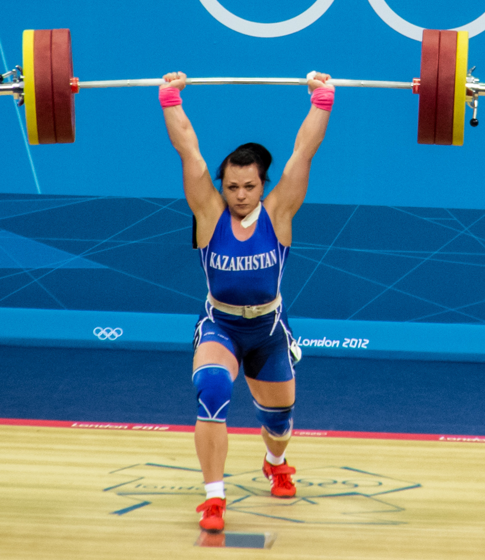
MENTAL SKILLS – AROUSAL
Optimal Arousal
Athletes need to recognise the relationship between how they feel on the inside & their performance levels on the outside. They should think about how they felt when they were in the zone & performances were outstanding, compared to feelings linked with poor performances.
Depending on a performer’s level of arousal, they may need to employ
Arousal Reduction or Arousal Promotion techniques.
https://commons.wikimedia.org/wiki/File:Svetlana_Podobedova_2012c.jpg
Home

Slide 21
MENTAL SKILLS – AROUSAL
Anxiety – a negative emotion and it is an individual interpretation of a situation.
Is a fear about “what might happen”. It is a fear of the unknown or fear of things you cannot control. The athletes arousal is being affected by negative feelings.
Results in somatic, cognitive and behavioral responses;
Somatic: Increase in heart rate, breathing rate and muscular tension
Cognitive: Fear of failure, loss of self-esteem, fear of judgment, increased alertness
Behavioural: Fidgeting, biting fingernails, avoiding eye contact
www.flickr.com/photos/30894945@N04/3176197951/
Home

Slide 22
MENTAL SKILLS – AROUSAL
Anxiety can improve performance even though it is a negative emotion.
Many excellent athletes have had successful careers based on;
Fear of failure
Fear of being judged
Fear of letting other people down
“ I play with a fear of letting people down. That's what motivates me.”
Johnny Wilkinson, English rugby player.
Too much anxiety can lead to “choking” when the performer fails to perform to their potential. High stress levels can lead to over arousal, resulting in the performer having a narrow – internal attentional focus leading to the missing of important cues and a diminished performance.
©PE STUDIES RESOURCES
Home

Slide 23
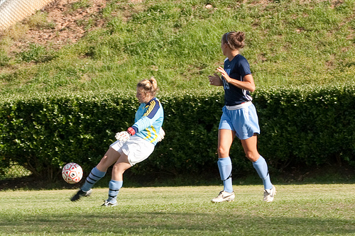
MENTAL SKILLS – AROUSAL
TWO types of anxiety:
State Anxiety
An immediate emotional state of fear, tension and increased arousal. Can change several times during performance and varies from player to player.
5 minutes left – scores equal
Middle of match
Game ends
Start of match
High anxiety
Anxiety drops
Anxiety increases
Anxiety drops
Home
©PE STUDIES RESOURCES

Slide 24
MENTAL SKILLS – AROUSAL
Trait Anxiety
Relates to the personality of the performer and how they perceive the situation – is it a challenge or threat?
A performer’s trait anxiety determines their individual response to this question.
A hockey player has to take a penalty flick in a “sudden death” situation. What affect does trait anxiety have on the performer?
A player with high trait personality would feel nervous, threatened by the demands of the task and fearful of the outcomes of their performance.
A player with low trait personality would have high self-esteem, be confident of their ability to score the goal and relaxed.
Athletes with high trait personality experience more state anxiety.
Home
©PE STUDIES RESOURCES

Slide 25
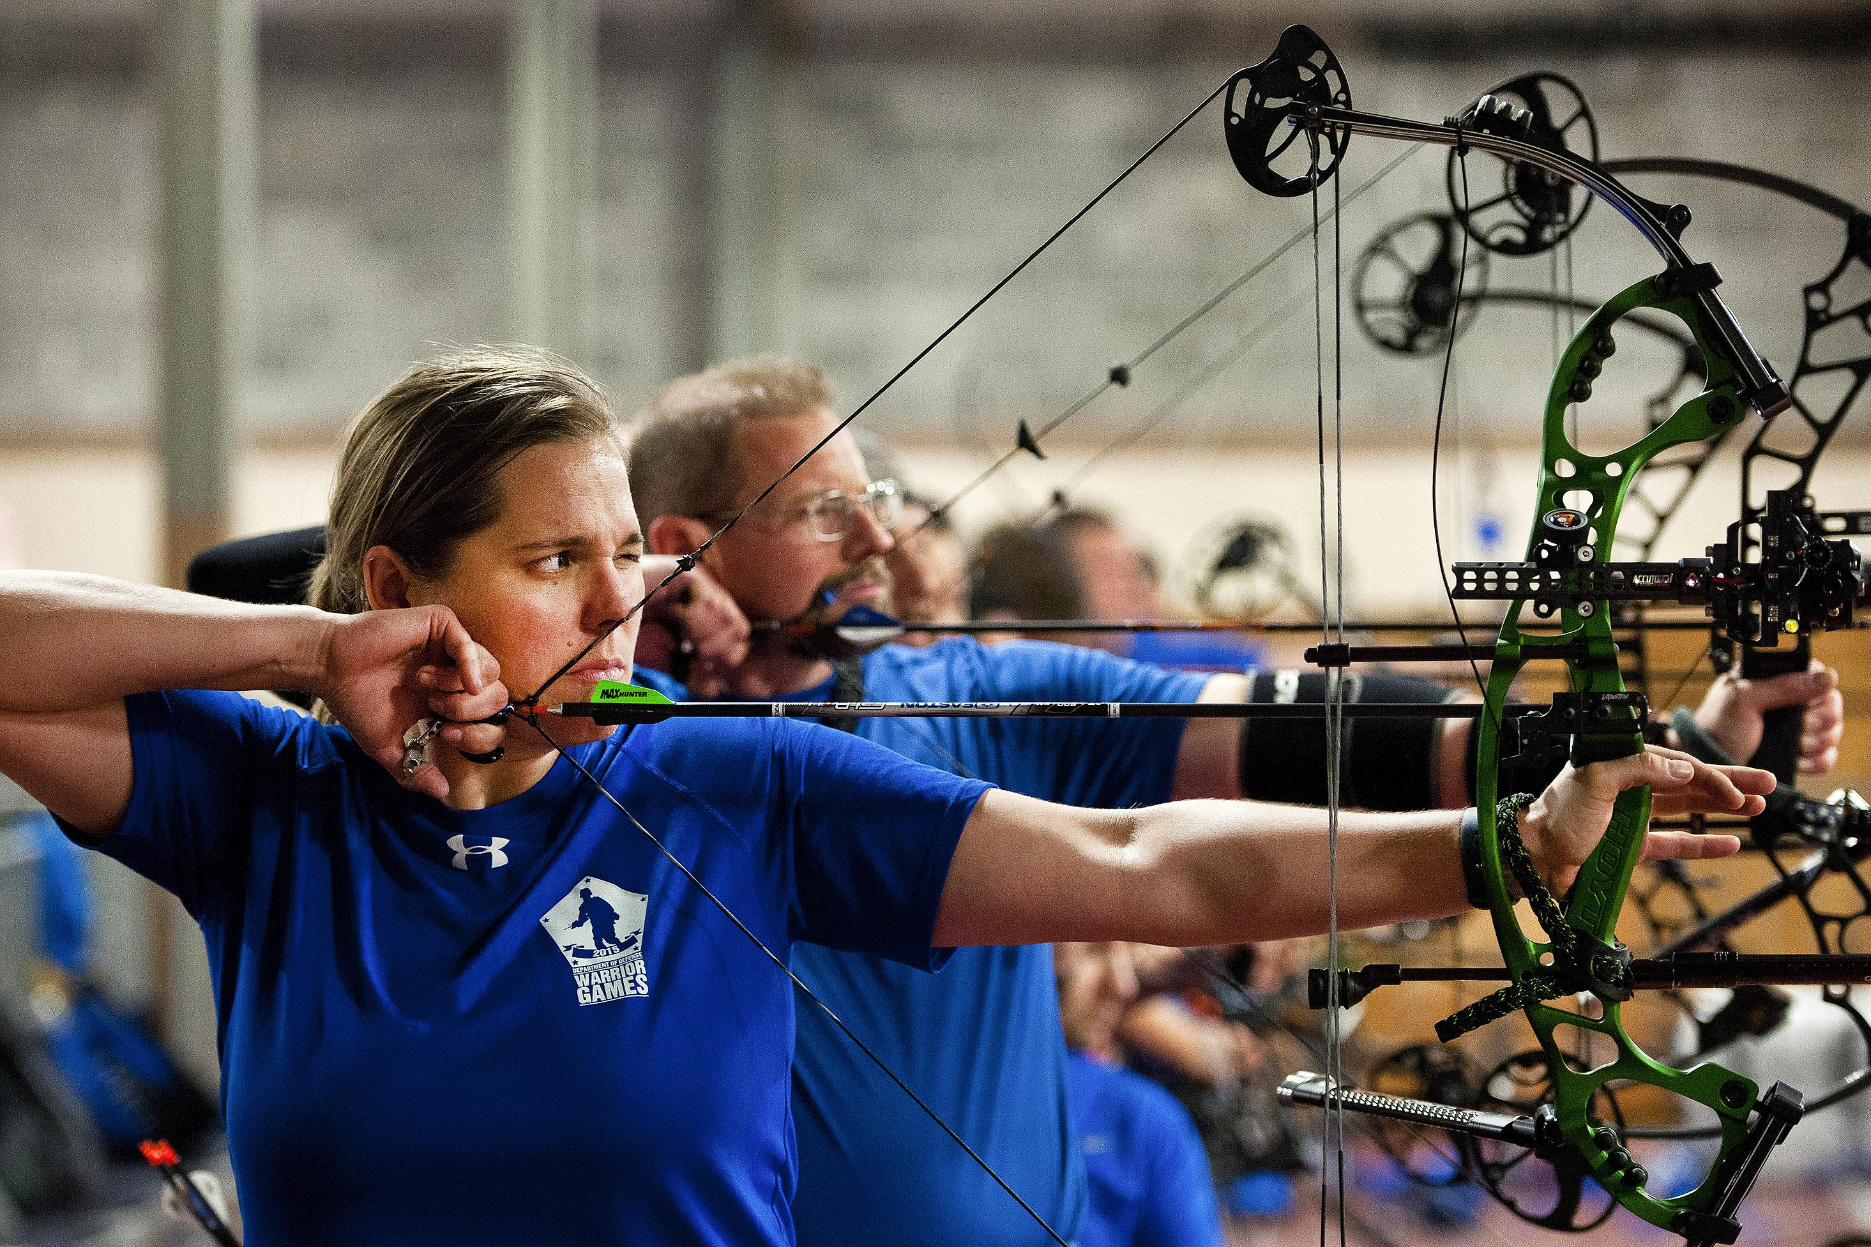
MENTAL SKILLS – AROUSAL
Strategies to reduce arousal and reach the ‘Zone’
The following techniques can be used to decrease arousal levels:
Meditation
Progressive Muscle Relaxation
Breathing control
Biofeedback
Stress inoculation training
Autogenic training
Home
https://commons.wikimedia.org/wiki/File:KOCIS_Korea_London_Olympic_Archery_Womenteam_12_(7682350412).jpg

Slide 26
MENTAL SKILLS – AROUSAL
Meditation involves focusing the mind on a particular thing for a certain period of time. It can involve using a mantra (repeating a calming word or sound), or using blank meditation.
Meditation is used to help reduce stress before an event
The aims of this technique are to calm the mind & relax the body
This technique is based on the simple premise of tensing (tightening) one muscle group at a time, followed by a release of the tension.
Through repetitive practice athletes quickly learn to recognise & distinguish between the associated feelings of a tensed muscle and a completely relaxed muscle.
With this simple knowledge, they can then induce physical muscular relaxation at the first signs of the tension that accompanies over-arousal & associated anxiety.
Meditation
Progressive muscle relaxation
Home

Slide 27
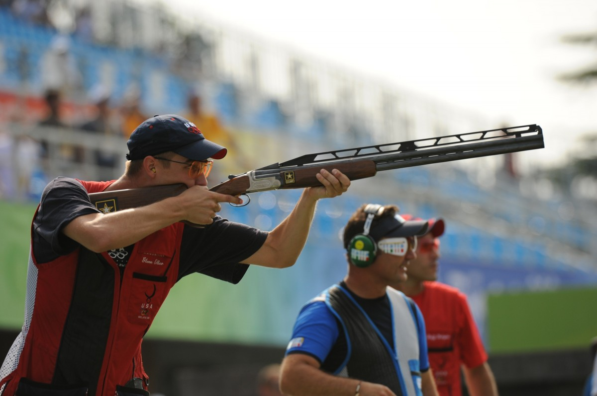
MENTAL SKILLS – AROUSAL
Some athletes use breathing techniques to help them relax & refocus while preparing for the next action or part of a match
Breathe deeply & slowly immediately before performing skill
Muscle tension decreases during exhalation
This technique can used before a putt in golf, a penalty flick in hockey and target sports such as archery, shooting
Breathing control
Home
https://pxhere.com/en/photo/745197

Slide 28
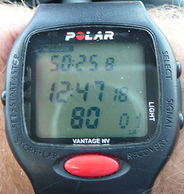
MENTAL SKILLS – AROUSAL
Is feedback regarding automatic body functions such as heart rate, blood pressure & body temperature, used to bring about mental adaptation.
Electronic instruments provide athletes with auditory or visual feedback on a range of physiological parameters such as heart rate, muscle tension & skin temperature.
These electronic devices either give a direct reading or emit sounds relative to the intensity of the stimulus.
With practice, the athlete learns to recognise the impact of over arousal on the body and can take steps to rectify the problem.
Biofeedback
www.flickr.com/photos/dumbledad/3417918660/
Heart rate monitors are a form of biofeedback
Home

Slide 29
MENTAL SKILLS – AROUSAL
Inoculate: expose the body to certain situations, so that it develops an immunity to that situation & is able to shut it out. As the name suggests, this practice inoculates athletes against the effects of stress.
By having athletes adapt, cope & work effectively when facing small amounts of stress, they build up immunity to stress
Coping comes in the form of developing positive thoughts, mental images & self-confidence statements.
A form of self-hypnosis requiring the athlete to perform a series of 6 mental exercises which bring about the sensations of warmth and heaviness.
This in turn has the effect of producing the physiological changes associated with the relaxation
Stress inoculation training (SIT)
Autogenic training
Home

Slide 30
MENTAL SKILLS – AROUSAL
Strategies to increase arousal and reach the ‘Zone’
Arousal promotion techniques include:
Pre-competition workout
Elevated breathing rate
Act energetically
Positive Self Talk
Energising mental imagery
Music
Pre game routine
https://commons.wikimedia.org/wiki/File:Steve_McNair_Tackle.jpg
https://commons.wikimedia.org/wiki/File:Weightlifting_at_the_2016_Summer_Olympics_%E2%80%93_Men%27s_94_kg_(15).jpg
Home

Slide 31
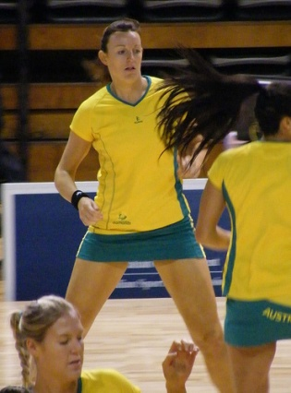
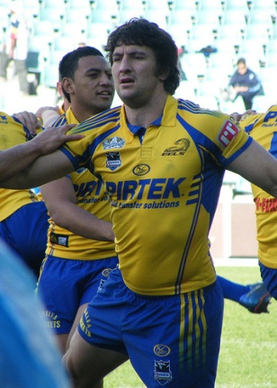
MENTAL SKILLS – AROUSAL
A pre-competition workout typically takes place a couple of hours before the actual game, performance or competition
Allows athletes to become accustomed to the playing field & conditions, go through set plays & pre-game conditioning
Following this, the players come out onto the field & perform warm-ups immediately before the game
As well as preparing themselves physiologically, they can practice some of the psychological techniques for enhancing performance
Pre competition workout
Pre-competition workout can be used to increase arousal levels
Home
www.flickr.com/photos/28990363@N05/2926919693/
www.flickr.com/photos/28990363@N05/2754890818/

Slide 32
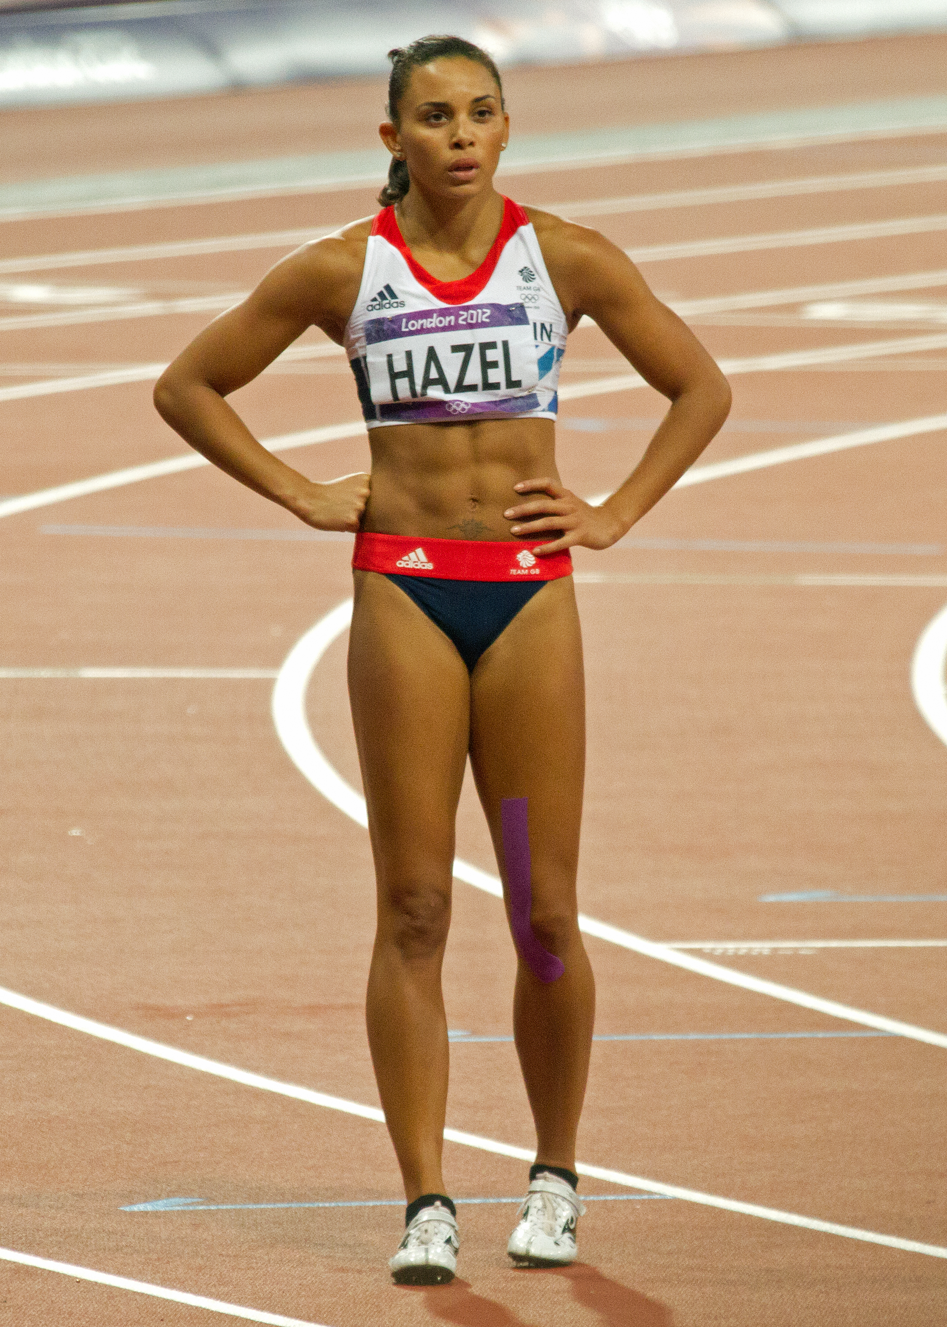
MENTAL SKILLS – AROUSAL
In the same way that breathing control can reduce tension & help to focus energy, taking short, sharp breaths activates the central nervous system & increases its state of awareness.
You may have seen football team-mates bumping into each other lightly, slapping each other & getting physical with each other in the change rooms or before taking to the field ⎯ this is a way of getting themselves pumped up!
Elevate breathing rate
Act energetically
https://en.wikipedia.org/wiki/Louise_Hazel
Home

Slide 33
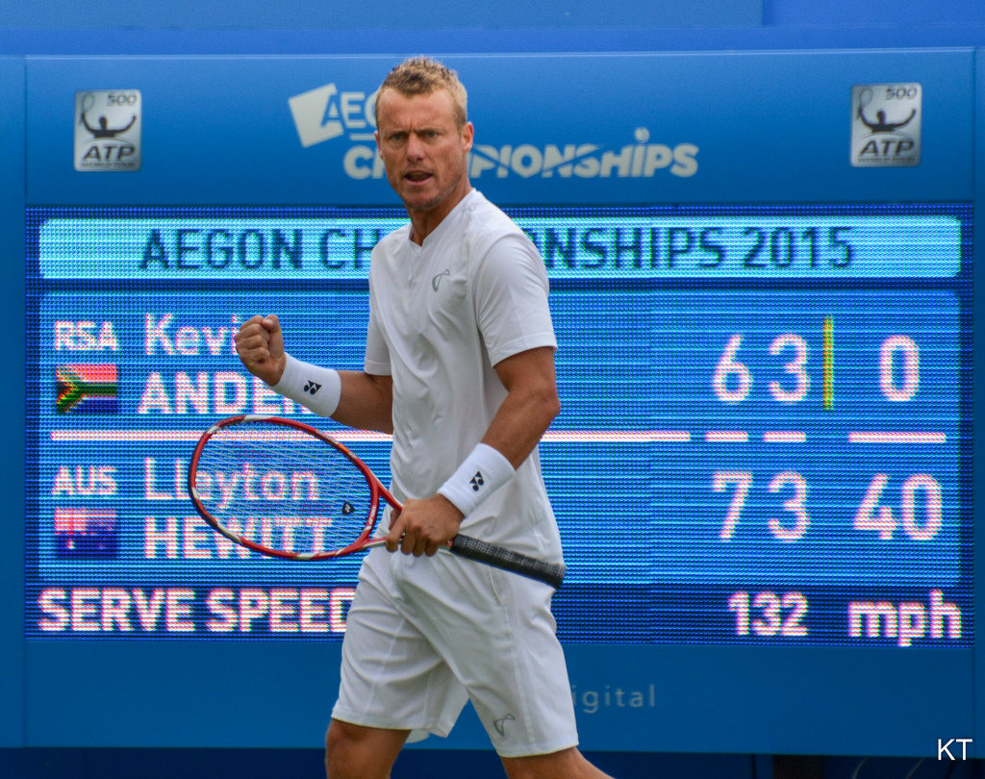
MENTAL SKILLS – AROUSAL
We know that the mind is a powerful tool that controls how we think and perform
While talking (to yourself or others), the use of emotive words such as tough, aggressive, hard-hitting, dependable, forceful, strong & commitment has been found to increase arousal levels
Positive self-talk
https://www.flickr.com/photos/43555660@N00/20100260475
Home

Slide 34
MENTAL SKILLS – AROUSAL
This type of mental imagery involves visualizing something that is uplifting & energizing to the athlete, & commonly involves performing with fine form.
Examples include:
A swimmer visualizing them self moving sleekly through the water like a seal
A surfer seeing herself cutting through the waves like a shark fin
An NFL player imagining that he is going to tackle opponents with the strength of a rhino
Mental imagery
Home
https://commons.wikimedia.org/wiki/File:Steve_McNair_Tackle.jpg
https://pixnio.com/sport/surfing/water-wave-sea-ocean-surfer-swimmer-beach-summer

Slide 35
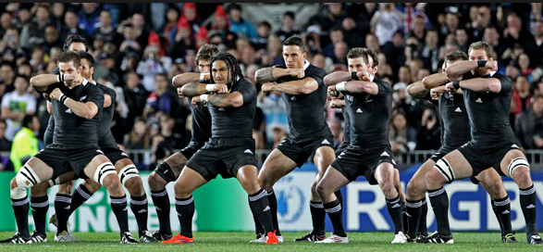
MENTAL SKILLS – AROUSAL
Listen to music that promotes enthusiasm or is associated with heroic efforts e.g. Rocky, Remember the Titans, Danger Zone.
Music is personal preference – not one song fits all as it may cause some players to become over aroused.
The music should be up-tempo with a rhythmic beat.
Music
https://pxhere.com/en/photo/963087
Performance routines before the game can be used to increase arousal levels
E.g. The All Black Haka is a pre-game performance ritual which increases their arousal level and aims to decrease the self-confidence of their opponents.
Pre game routine
https://commons.wikimedia.org/wiki/File:Rugby_world_cup_2011_NEW_ZEALAND_ARGENTINA_(7309676784).jpg
Home

Slide 36
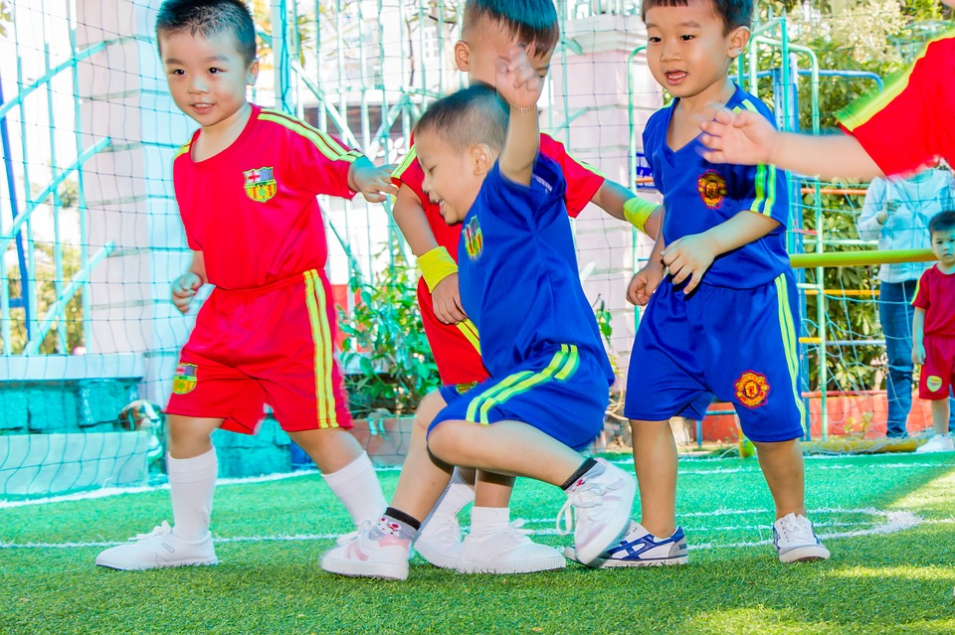
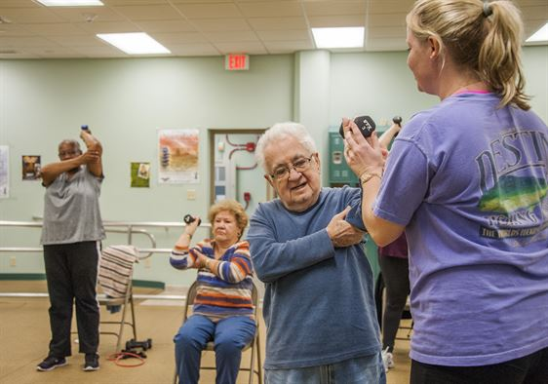
MENTAL SKILLS – AROUSAL
Influence of age
Whilst age has no direct relationship on the optimal arousal level and performance, it can be related to skill level and therefore we typically see the following;
Young children are typically less skilled and therefore require a lower level of arousal to produce optimal performance
Adults are typically more skilled and therefore require a higher level of arousal to produce optimal performance
The elderly are typically less skilled and therefore require a lower level of arousal to produce optimal performance
Home
https://pixabay.com/photos/young-children-male-sport-soccer-1280663/
https://www.airforcemedicine.af.mil/News/Tag/68228/elderly-fitness/

Slide 37
MENTAL SKILLS – AROUSAL
Influence of skill level
Optimal arousal level is dependent on the skill level and experience of the performer.
An advanced player needs higher levels of arousal to perform optimally
An intermediate level player needs a moderate level of arousal
A novice only needs a low arousal level to perform at their peak
https://commons.wikimedia.org/wiki/File:2017%E2%80%9318_W_Ashes_A_v_E_Test_17-11-11_Perry_(01).jpg
Home

Slide 38
MENTAL SKILLS – AROUSAL
Influence of skill level
Optimal Performance / Arousal
Advanced player
Performance
Intermediate player
Novice player
Arousal
Home

Slide 39

MENTAL SKILLS – AROUSAL
Influence of activity type
Task complexity influences optimal arousal levels for individuals
Tasks which are considered ‘hard or complex’ – i.e. require large amounts of information processing or movement precision are best performed with low arousal levels
E.g. golf putt
Tasks which are considered ‘easy or simple’ – i.e. require small amounts of information processing and involve gross motor movements are best performed with high arousal levels
E.g. weight lifting
https://commons.wikimedia.org/wiki/File:Weight_lifting_black_and_white.jpg
Home

Slide 40
MENTAL SKILLS – AROUSAL
Influence of activity type
Optimal Performance/Arousal
Hard task
Easy task
Performance
Arousal
A hard task requires a lower arousal level to produce optimal performance than a simple task which requires a higher level of arousal to produce peak performance
©PE STUDIES RESOURCES
Home

Slide 41
MENTAL SKILLS – AROUSAL
Influence of activity type
Putting in golf
Volleyball serve
Rugby tackle
Bench press
Performance
Arousal
©PE STUDIES RESOURCES
Home

Slide 42
GOAL SETTING
Evaluation and reassessment of personal goals according to changing situations
age
skill level
type of activity
School Curriculum and Standards Authority. Physical Education Studies ATAR Year 11 Syllabus, 2016.
Home

Slide 43

GOAL SETTING
Goal Setting – The process of deciding on something you want to achieve, planning the steps to follow that will help reach the goal, and then working towards achieving the goal.
Goal setting occurs when athletes set down clear targets,
priorities and expectations
Athletes are more committed when they have a goal and
must be set for both training and competitions
Can affect many aspects of performance during training and competition, and has been shown to increase work output by up to 40 – 50%
Goal setting improves performance by:
focusing attention on important elements of the skill(s)
activating & organising an athlete’s efforts
encouraging perseverance
promoting the development of new learning strategies
refining movements & set plays
contributing towards a positive psychological state
https://pixabay.com/en/photos/aim/
Home

Slide 44
GOAL SETTING
Type | Focus | Features | Example
Outcome Goals | End results, times, finishing place, ranking or medals | Often difficult to achieve as can be linked to the achievement of others | Win the New York marathon
Performance Goals | Independent of other competitors – can be used to compare past and present performance | Excellent for improving performance as athlete has control over the behaviour. Goals must be realistic for self confidence to improve | Improve free throw percentage from 70% to 80% this season
Process Goals | Actions (such as physical movement & game strategies) that athletes must perform during a competition to achieve a performance goal | Effective at improving performance levels because they positively influence other factors such as self-efficacy & confidence | Successfully execute a set play from a free kick in soccer
Home

Slide 45
GOAL SETTING
It is preferable to use a multi-goal approach: Make the finals (outcome), score 10 points per game (performance), make gooseneck when shooting (process).
If an athlete is able to achieve their set process goal, this should contribute towards the achievement of the set performance goals.
Achieving performance goals will contribute towards achieving outcome goals.
https://www.gq.com/story/elena-delle-donne-wnba
Home

Slide 46
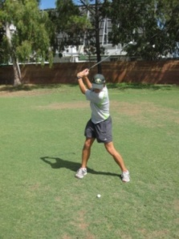
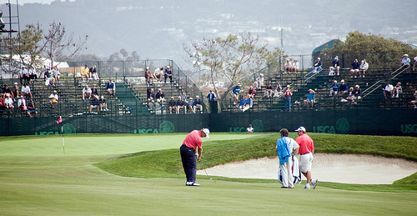
GOAL SETTING
Short term goals help you attain long term goals – they are stepping stones to help you maintain focus on the long term goal by setting achievable short term targets
Long term goals are achieved by attaining the short term goals and over a long period of time
Tour School
Win amateur title
State Team
State Squad
Club Champion
Club 1st grade
www.flickr.com/photos/dirkhansen/2577929257/
Home

Slide 47
GOAL SETTING
Goal Setting – Guidelines (please note variations of the SMARTER principle exists)
SMARTER | DESCRIPTION | EXAMPLE (volleyball)
Specific | Goals need to be specific and as clear as possible to focus attention. | To use a float serve in volleyball effectively
Measurable | Need to be able to be assessable to see if progress is happening | To land the serve within the back court on 8 out of 10 attempts during training (2 x per week).
Accepted | Goals need to be accepted by all parties involved in preparing the athlete (coach, family, etc.) | ‘Okay, we’re all agreed.’
Realistic | Goals need to be achievable and within the athlete’s capacity | 80% success rate is realistic for this player.
Time Phased | Specific date for completion needs to be set | 22nd November
Exciting | The athlete needs to be challenged and inspired. | Create a game from the goal that can be used at training
Reviewed | Goals are monitored and adjustment made if necessary. | Goal has been met and now needs to be readjusted to ensure the player is still stimulated
Home

Slide 48
GOAL SETTING
Influence of age
Younger performers respond better to short term goals which are achievable – such goals provide motivation for the developing player.
Coaches must be careful when setting goals for junior athletes as they may not have the skills to cope with failure as well as older athletes
As a result it is important for younger athletes to focus on setting achievable performance goals
As players get older, the goals set can become more challenging and the time taken to achieve these goals can be extended.
With increasing age, athletes must regularly evaluate and reassess their goals to ensure they remain realistic, particularly as their performance drops due to reduced physiological capacities.
https://commons.wikimedia.org/wiki/File:Irada_Aliyeva._Athletics_at_the_2016_Summer_Paralympics_%E2%80%93_Women%27s_javelin_throw_F13_4.jpg
Home

Slide 49
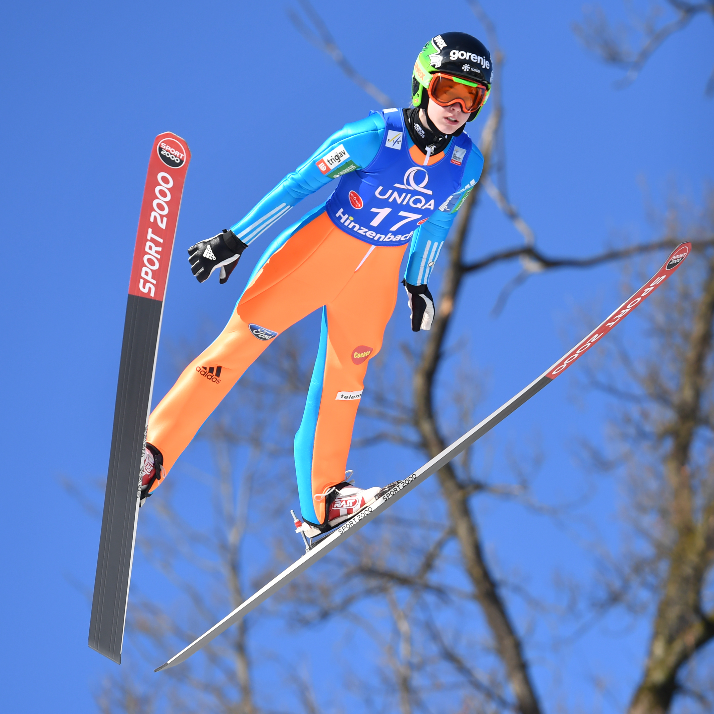
GOAL SETTING
Influence of skill level
Irrespective of skill level, it is vital coaches and athletes follow the principles of goal setting or they become ineffective.
Novice athletes starting out may simply set goals relating to the basic skills of the game and as the skills become more automated, the goals may change to relate more to the learning of strategies and tactics
Novice athletes who set goals which cannot be achieved decrease motivation levels and can lead to drop out from the sport.
Professional athletes must also set goals which are both challenging yet achievable otherwise this can lead to loss of motivation
https://commons.wikimedia.org/wiki/File:20170205_Ski_Jumping_World_Cup_Ladies_Hinzenbach_8124.jpg
Home

Slide 50
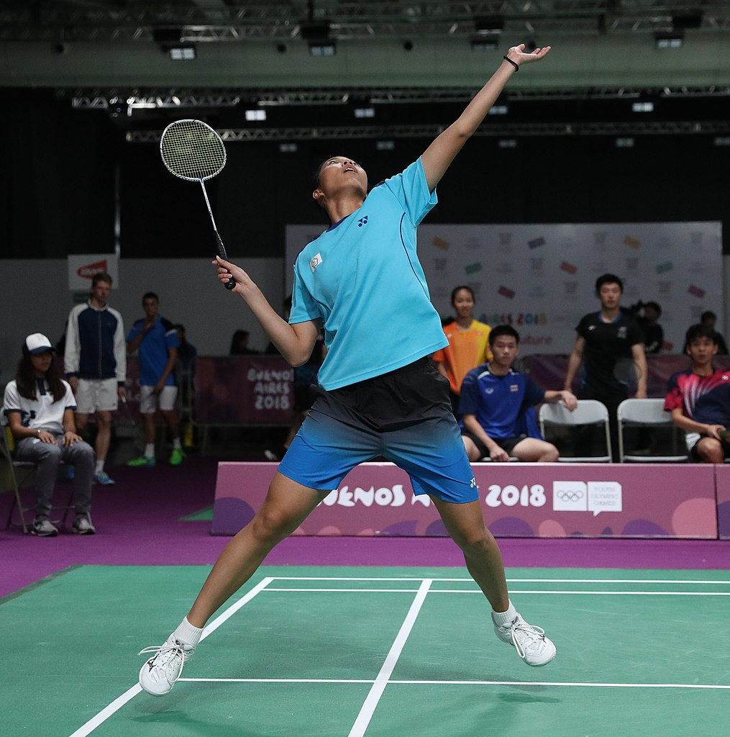
GOAL SETTING
Influence of activity type
Goal setting for a player who only wants to play socially for the local community team is different from a player who wants to play at a much higher level.
Furthermore, the use of performance, outcome and process goals may vary from sport to sport
Some sports, like swimming, make it very easy to use performance goals as they are independent of the performance of others
Other sports may rely more heavily on process or outcome goals
https://fr.wikipedia.org/wiki/Fichier:2018-10-12_Badminton_Mixed_International_Team_Final_match_8_at_2018_Summer_Youth_Olympics_by_Sandro_Halank%E2%80%93004.jpg
Home

